Slide 1
Windows Server 2025
Course introduction | Foundations, administration, security, hybrid management, and hands-on labs

Slide 2
Course flow
01 FOUNDATIONS
Chapters 1-4: platform concepts, management methods, Git, and command-line administration
02 CORE ADMINISTRATION
Chapters 5-8: daily operations, setup, identity, and local storage
03 SECURE OPERATIONS
Chapters 9-12: trust, file access, monitoring, and licensing
04 HYBRID AND PLATFORM
Chapters 13-17: Azure Arc, Hotpatch, Hyper-V, LAPS, and networking

Slide 3
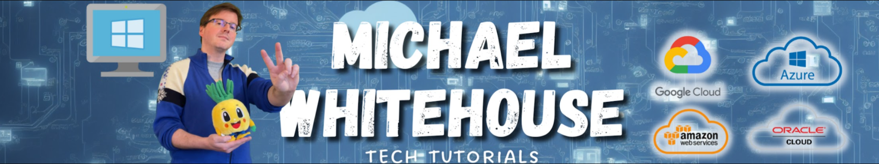
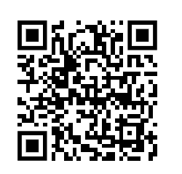
YouTube: youtube.com/@mwcloud
GitHub: github.com/kramit
Email: mike@michaelwhitehouse.com

Slide 4
Prepare for the hands-on labs
Open the GoDeploy learning platform
Launch the assigned lab, follow the guide one change at a time, and validate the stated result before moving on.
https://lms.godeploy.it
Sign in with the access details supplied for the course.

Slide 5
Chapter 1: Introduction to Windows Server
01 Applications
02 Security concepts
03 Services
04 Windows Server architecture
Lab 1: Exploring the Windows Server interface and basic configuration

Slide 6
Chapter 2: Methods and Tools for Administration
01 Management tools
02 Local and remote administration
03 Role-based administration
Lab 2: Using remote administration tools and PowerShell

Slide 7
Chapter 3: Introduction to Git and GitHub
01 Introduction to Git and version control
02 Working with a local repository
03 Branching in Git
04 GitHub, pull requests, and collaboration
Lab 3: Working with Git and GitHub

Slide 8
Chapter 4: Command-Line Administration Tools
01 Command-line hosts
02 Windows Terminal
03 CMD.EXE
04 PowerShell
Lab 4: PowerShell command-line administration

Slide 9
Chapter 5: Common Administrative Tasks
01 Managing roles and features
02 Managing services
03 Reviewing events
04 Configuring firewall
05 Patch management
Lab 5: Installing server roles and managing firewall

Slide 10
Chapter 6: Manual Setup and First Configuration
01 Setup
02 Server with Desktop Experience
03 Server Core
04 sconfig
05 Secured-core server
06 Security hardening
Lab 6: Post-installation configuration and security hardening

Slide 11
Chapter 7: Managing Users, Computers, and Groups
01 Local users
02 Active Directory basics
03 Domain users
04 Groups
05 Computers
Lab 7: Creating and managing Active Directory users and groups

Slide 12
Chapter 8: Managing Local Storage
01 Disks
02 Partitions
03 Volumes
04 NTFS
05 ReFS
06 RAID
07 Mount points
08 Storage Spaces and Storage Replica
Lab 8: Managing disks, volumes, and NTFS permissions

Slide 13
Chapter 9: Introduction to PKI
01 PKI applications
02 Algorithms
03 Certificate management
04 Installing and enabling OpenSSH Server
05 Configuring SSH for remote administration
06 Managing key-based authentication
Lab 9: Installing OpenSSH and configuring secure remote access

Slide 14
Chapter 10: Managing Permissions and Shares
01 Permissions
02 Shares
03 Offline Files
04 Volume Shadow Copies
05 Introduction to Group Policy
Lab 10: Creating file shares and managing share permissions

Slide 15
Chapter 11: Performance Monitoring
01 Counters
02 Live monitoring
03 Data collection
04 Monitoring and troubleshooting
Lab 11: Monitoring server performance and resource usage

Slide 16
Chapter 12: Licensing
01 Windows Server editions
02 Licensing
03 Windows Server Pay-as-you-go
04 Virtualization rights
05 Azure Hybrid Benefit
Lab 12: Understanding Windows Server licensing and activation

Slide 17
Chapter 13: Azure Arc
01 Introduction to Azure Arc
02 Connecting Windows Server machines
03 Hybrid server management and governance
04 Policy, inventory, and update management
Lab 13: Connecting Windows Server to Azure Arc

Slide 18
Chapter 14: Windows Hotpatch
01 Introduction to Windows Hotpatch
02 Prerequisites and supported scenarios
03 Enabling and managing Hotpatch
04 Patch cadence and reduced reboot requirements
Lab 14: Understanding patching and update management

Slide 19
Chapter 15: Hyper-V and Containers
01 Introduction to Hyper-V
02 Installing and configuring the Hyper-V role
03 Creating and managing virtual machines
04 Virtual networking and storage for Hyper-V
Lab 15: Installing Hyper-V and creating virtual machines

Slide 20
Chapter 16: Windows LAPS
01 Introduction to Windows LAPS
02 Managing local administrator passwords securely
03 Configuring LAPS policies
04 Password rotation and retrieval
Lab 16: Configuring Local Administrator Password Solution

Slide 21
Chapter 17: Networking Basics
01 Networking basics
Lab 17: Configuring network settings and TCP/IP

